Slide 1
Capstone 2
Multiclass document classifier

Slide 2
Problem
Create a tool for records managers to classify and sort electronic records.
To start we will sort documents into three classes – Operations, Accounting, and Legal

Slide 3
Data wrangling and assumptions
The dataset was preselected and provided by MIDCON to fit one of three classes. None of the documents fall outside the thee classes.
All of the documents origin from 2016. However, by nature the operations reports are unfairly rooted in 2016. While the accounting documents will be forward looking to 2017.

Slide 4
Algorithms and Transformers
Count Vectorizer
Hash Vectorizer
Tfidf Transformer
Stochastic Gradient Decent
Support Vector Machine

Slide 5
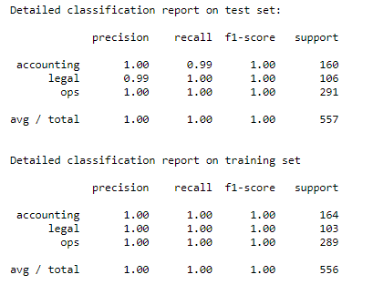

Top Result Sgd Classifier and tfidfvectorizer

Slide 6
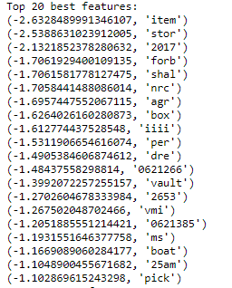
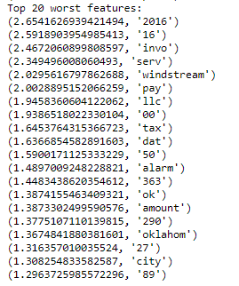
Feature analysis log probabilities of feature

Slide 7
Feature Analysis most repeated tokens

Slide 8
Conclusion
The model achieved desired result.
There were only small variations between the tested classifiers/text transformers. This could mean that the dataset was too narrow in focus.
Next steps that could improve the model:
Increase the variety and complexity of the dataset
Try an unsupervised approach, and compare topic extraction results to current approach to understand which is more applicable to records managers.

